Slide 1
CSE7302 – University Project Review-2 Presentation Al-Based Internship Recommendation Engine for PM Internship Scheme
20221CBC0001 | Cheerla Nithin
20221CBC0002 | Shaik Julpin
20221CBC0010 | Akula Naga Divya Darshini
Roll Number | Student Name
Under the Supervision of,
Mr. Bailappa Bhovi
Associate Professor
School of Computer Science and Engineering
Presidency University
Name of the Program: Capstone Project
Name of the HoD: Dr .Pravinthraja S
Name of the Program Internship Coordinator: Dr .H M Manjula
Name of the School Internship Coordinator: Dr. Sampath A K , Dr. Geetha A

Slide 2
Content
About Company or Organization
Working domain or the technology
About your team and reporting Manager
Challenges Faced in Internship
Objectives of the work
Literature Review
Proposed System
Problem Statement
System Requirements
Advantages of Proposed System/Work
Internship Roadmap
Github Link

Slide 3
About Company or Organization
1. Ministry of Education & PM Internship Scheme The Government of India, through the Ministry of Education and associated national skill development bodies, continuously works toward improving youth employability and industry readiness. The PM Internship Scheme is a flagship initiative designed to provide students with practical exposure, hands-on experience, and skill development opportunities across various sectors. The scheme aims to bridge the gap between academic learning and industry requirements by connecting students with verified internship opportunities from government departments, public sector organizations, and partnered private institutions. This initiative supports the national vision of building a skilled, digitally empowered, and employment-ready workforce.
2. Role of Technology in Supporting the Scheme With the rapid increase in applicants and internship opportunities, manual management and allocation of internships becomes inefficient. Digital platforms powered by Artificial Intelligence can significantly enhance the effectiveness of such schemes by enabling intelligent matching between students and internships. Our proposed AI-based internship recommendation platform supports the objectives of the PM Internship Scheme by automating candidate–internship matching, providing resume analysis, and offering career guidance. This ensures fair access, transparency, and better utilization of internship resources while improving student success rates.

Slide 4
Working domain or the technology
1. Domain: Artificial Intelligence in Recruitment & Career Guidance The project falls under the domain of Artificial Intelligence and Data Science, specifically focusing on intelligent recruitment systems and career recommendation platforms. It uses machine learning and natural language processing (NLP) techniques to analyze resumes, student profiles, and internship descriptions. The system matches students with suitable internships based on skills, interests, education, and experience, making the selection process faster and more accurate.
2. Technologies Used The system uses a web-based architecture with frontend technologies such as HTML, CSS, JavaScript, and React.js for building interactive user interfaces. The backend is developed using Node.js and Express.js, while MySQL is used for database management. Python is used for implementing machine learning models such as resume analysis and similarity matching.

Slide 5
About your team and reporting Manager
1. Team Composition Our team consists of Three engineering students with interests in Artificial Intelligence, Web Development, and Software Engineering. Each member contributes to different aspects of the project such as frontend design, backend development, database handling, and AI model implementation.
2. Reporting Manager / Guide The project is carried out under the guidance of a Mr.Dinesh mentor who provides continuous technical support and direction. Regular reviews and feedback sessions help in improving project quality and ensuring timely progress.

Slide 6
Objectives of the work
Intelligent Internship Recommendation To develop an AI-based system that recommends suitable internships to students based on their profile and skills.
Resume Analysis and ATS Scoring To provide resume evaluation, identify strengths and weaknesses, and give improvement suggestions

Slide 7
Literature Review
• Recent studies show that AI and NLP are widely used for resume analysis and job/internship matching. • Transformer-based models such as BERT and Sentence-BERT provide better semantic matching than keyword-based systems. • Hybrid recommendation systems improve personalization and accuracy. • ATS score prediction models simulate how companies shortlist resumes. • Most existing systems are recruiter-focused and not student-centric. • There is limited research on integrated internship recommendation with resume feedback for students.

Slide 8
Proposed System / Work
• AI-based platform for recommending internships based on student profile and resume. • Uses machine learning and NLP for intelligent matching. • Includes resume analyzer and ATS score checker. • Provides strengths, weaknesses, and improvement suggestions. • Supports PM Internship Scheme objectives. • Improves matching accuracy and student preparedness.

Slide 9
Problem Statement
• Students struggle to find suitable internships. • Lack of personalized internship guidance. • Students are unaware if resumes are ATS-friendly. • High rejection rate due to poor resume quality. • Need for unified intelligent system.

Slide 10
System Requirements
Software Requirements:
1.Operating System:Windows 10 /11
2.Programming Language:Python 3
3.Backend Framework:Flask
4.Frontend Technologies:HTML,CSS,JavaScript
5.Database:SQL
6.ML Libraries : Scikit-learn , Pandas, NumPy
7.IDE:VSCode

Slide 11
.
Hardware Requirements:
System: Laptop / Desktop
Processor: Intel i3 / i5 / Ryzen 3 or above
RAM: Minimum 4 GB (8 GB recommended)
Storage: 10 GB free space
Internet: Required (for libraries / internship data)
Display: Any standard monitor

Slide 12
Advantages of Proposed System/Work
• Personalized internship recommendations. • Automated resume evaluation. • Saves time and effort. • Improves employability. • Transparent and user-friendly system.

Slide 13
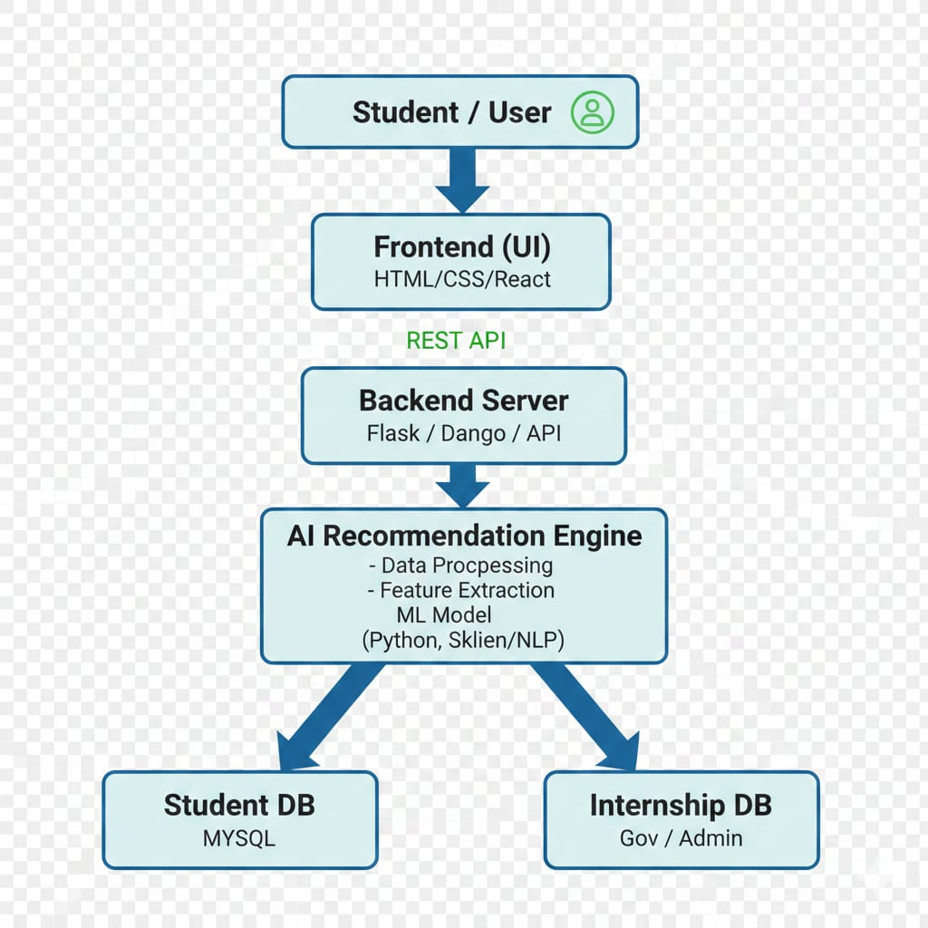
Road Map for Project

Slide 14
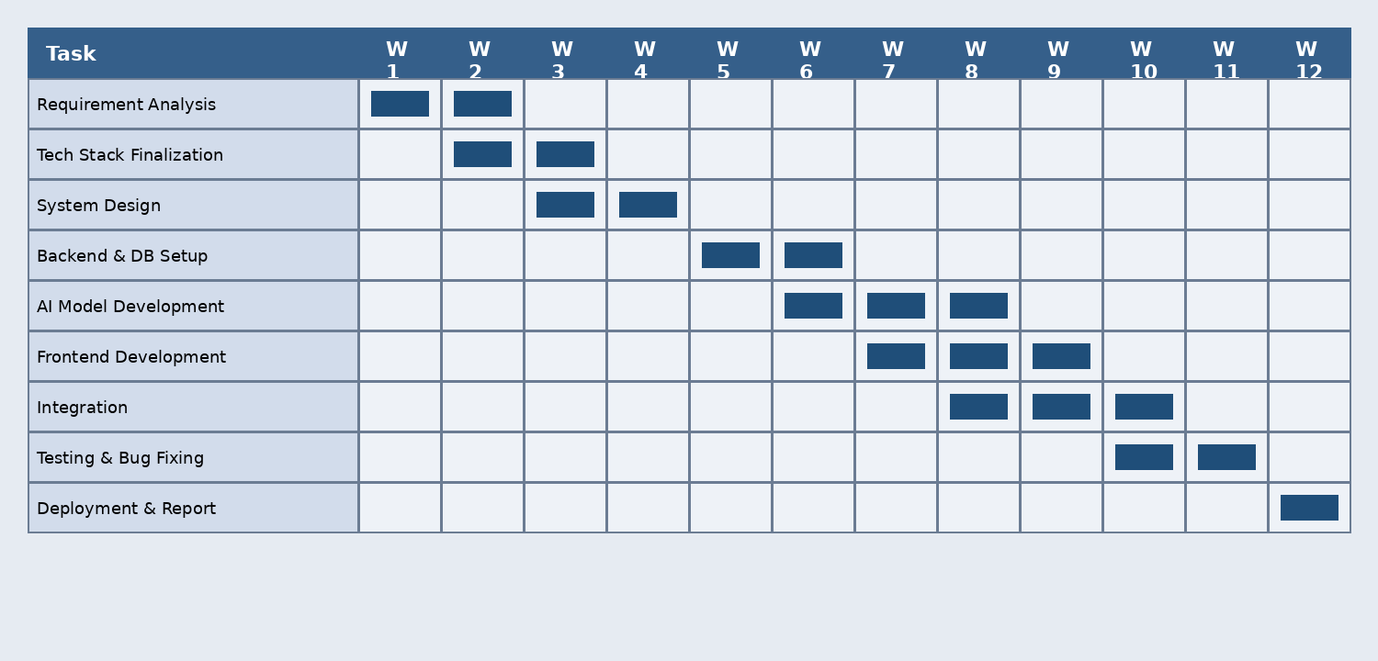
Timeline of the Project (Gantt Chart)
Chart:

Slide 15
Github Link
The Github link provided should have public access permission.
https://github.com/Akula929/AI-based-PM-Internship-Scheme

Slide 16
Q&A

Slide 17
Thank you !!

